Slide 1
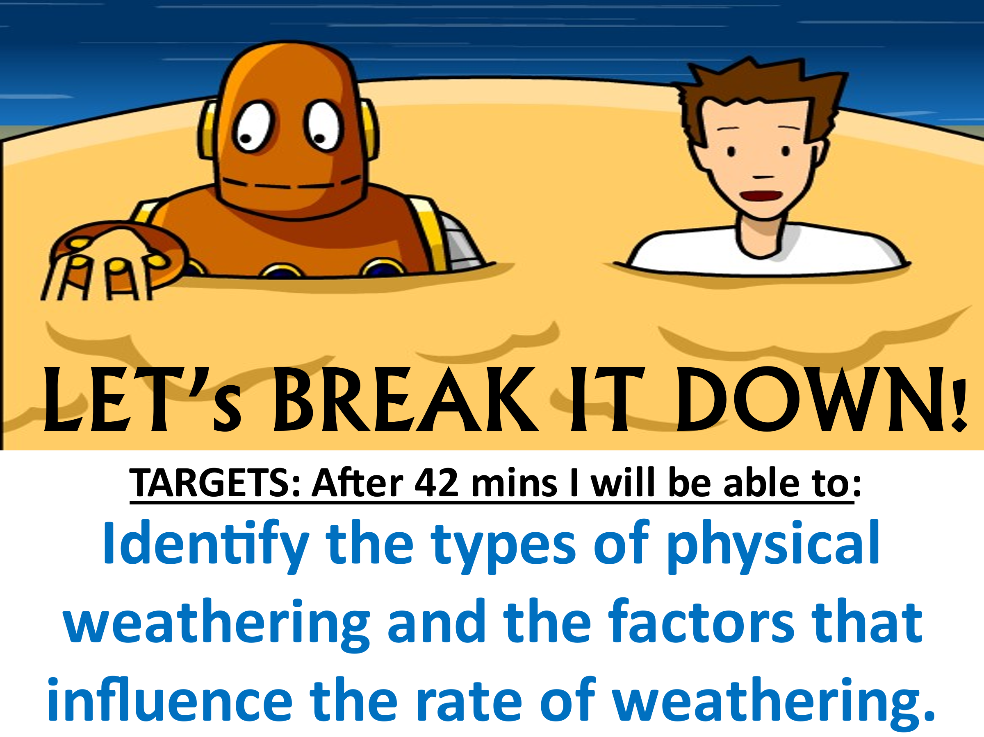

Slide 2
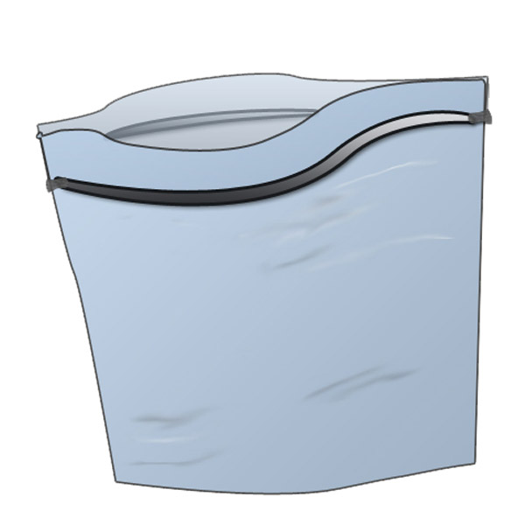
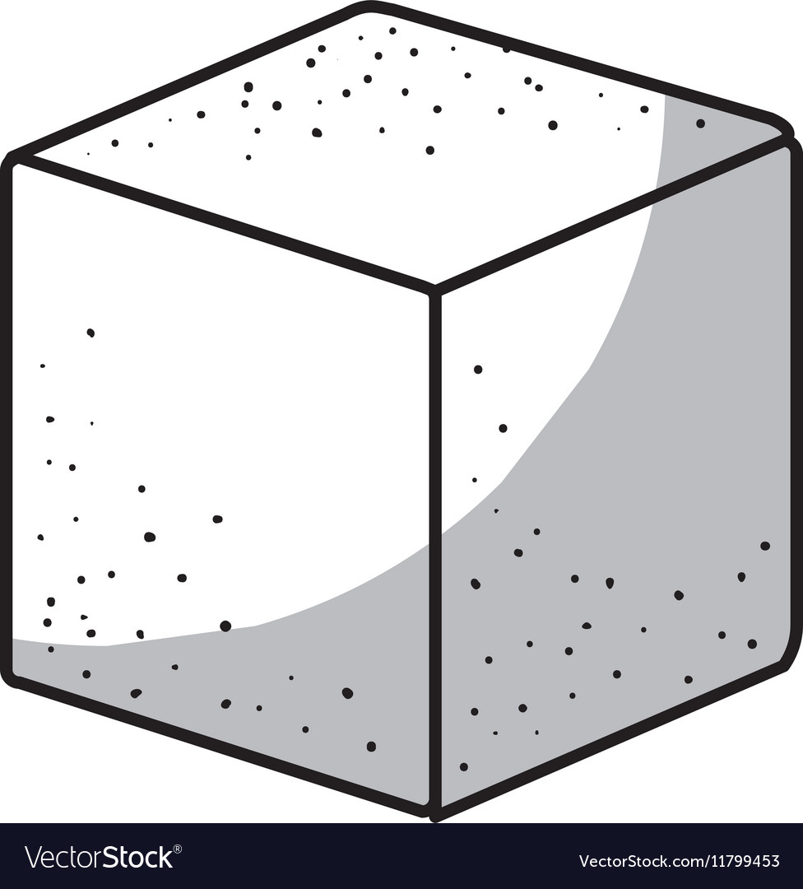
I. Introduction Activity:
Materials:
1 Sugar Cube & 1 plastic resealable bag

Slide 3
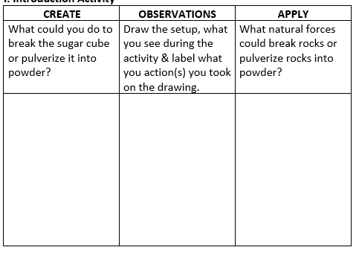

Slide 4
TODAY WE ARE FOCUSING ON:
PHYSICAL WEATHERING

Slide 5
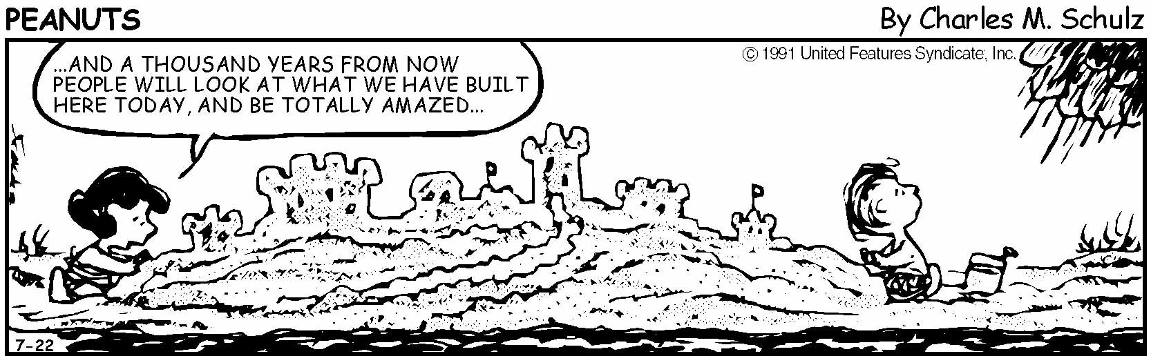
THINK ABOUT IT ☺
Q. Give at least 3 ABIOTIC reasons why Lucy’s sandcastle will NOT be around a thousand years from now:
Rain will wash it away.
Ocean waves break it down.
Wind can blow it away.

Slide 6

I WONDER WHY?
Why don’t we use glasses bottles to store water in a freezer?
Raw Video: Deep-freeze Shatters Bottle – YouTube
1:40 mins

Slide 7
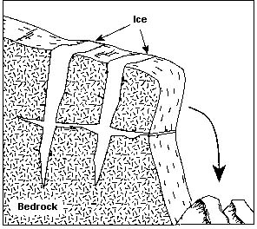
II. 4 TYPES OF PHYSICAL WEATHERING:
Water gets into cracks,
__________ & __________,
This BREAKS the rock apart!
FREEZES EXPANDS

Slide 8
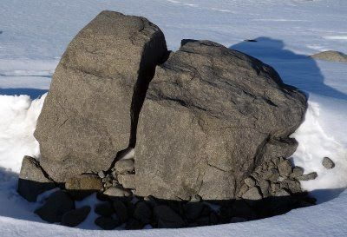
This is called…
FROST ACTION
_________________________________
or
_________________________________
Temperature needs to _______________ between freezing & melting temperatures.
ICE WEDGING
alternate

Slide 9



THIS CREATES A….
POTHOLE

Slide 10
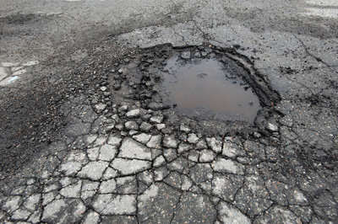

Slide 11
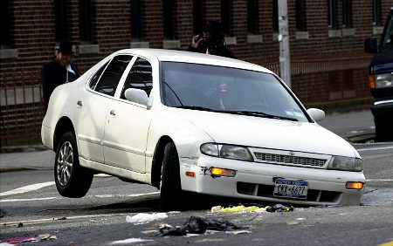
BYE BYE TIRE!

Slide 12
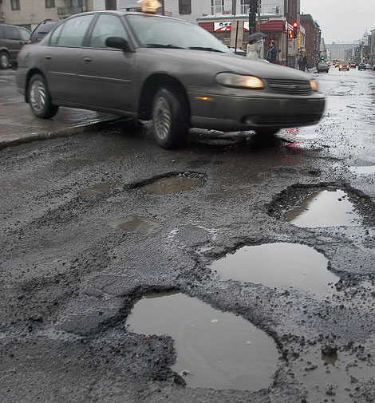
WATCH OUT!

Slide 13
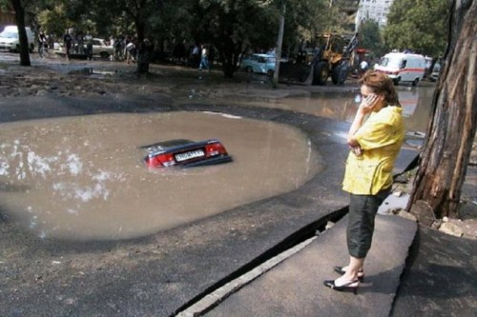
Some can be very large

Slide 14
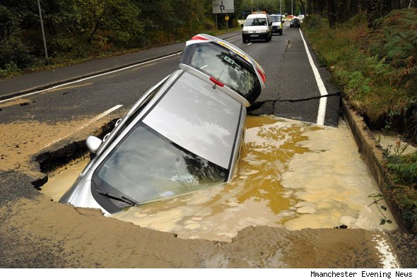

Slide 15
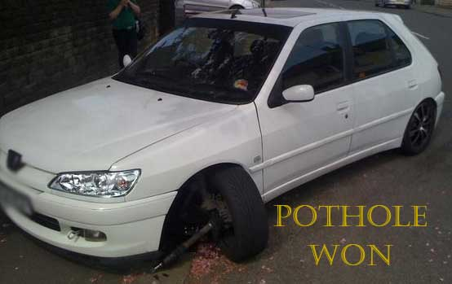
Pothole Commercial
https://www.youtube.com/watch?v=NjMUfIKktWU

Slide 16
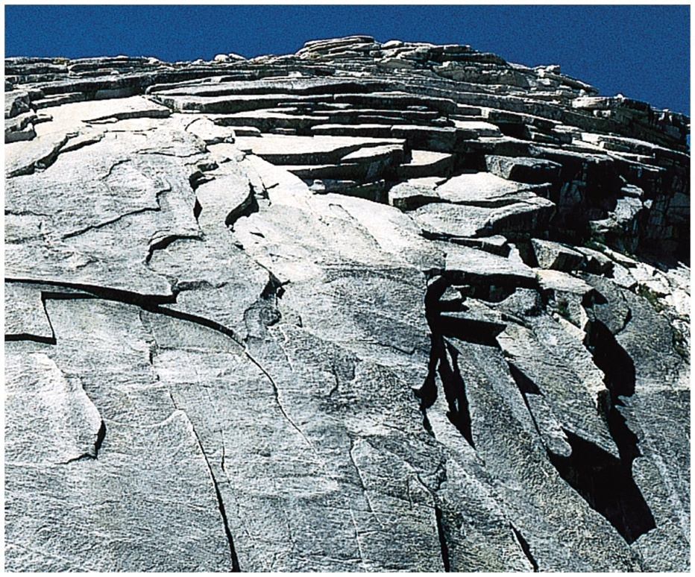
2. ___________________________
EXFOLIATION:
Top layer “PEELS” or BREAKS off

Slide 17
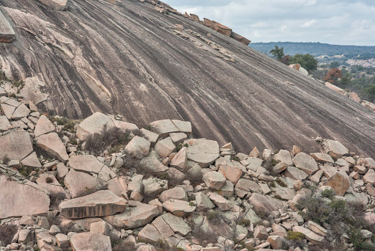
\

Slide 18
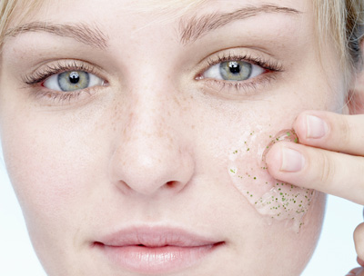
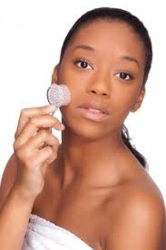
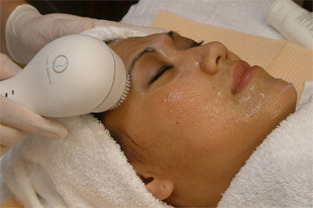
EXFOLIATE YOUR FACE!

Slide 19
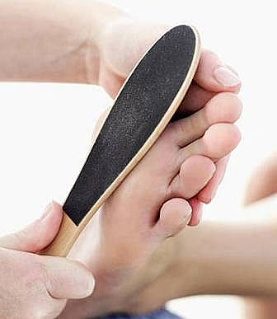
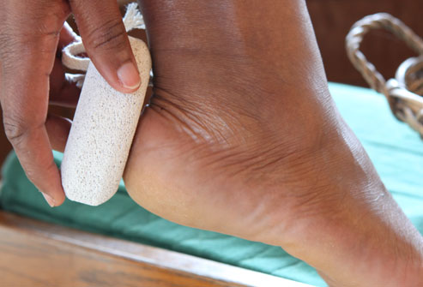
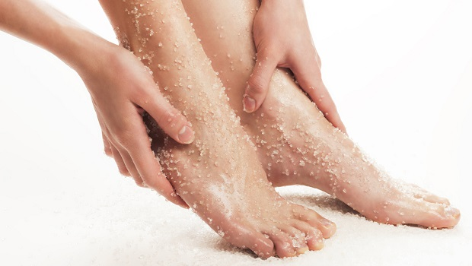
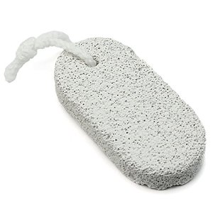
EXFOLIATE YOUR FEET!

Slide 20
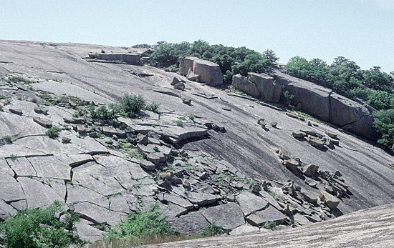
EXFOLIATE THE ROCK!

Slide 21
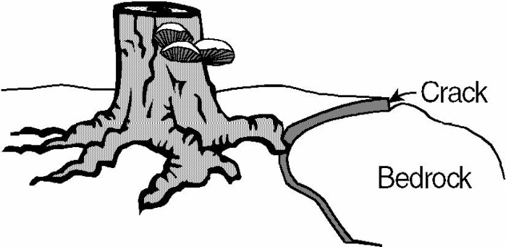
3. _________________________
BIOLOGICAL ACTIVITY
Tree roots can break the ground.
Animals too!

Slide 22
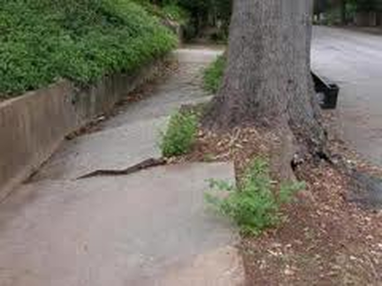

Slide 23
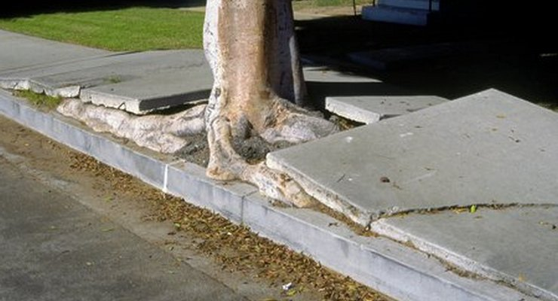

Slide 24
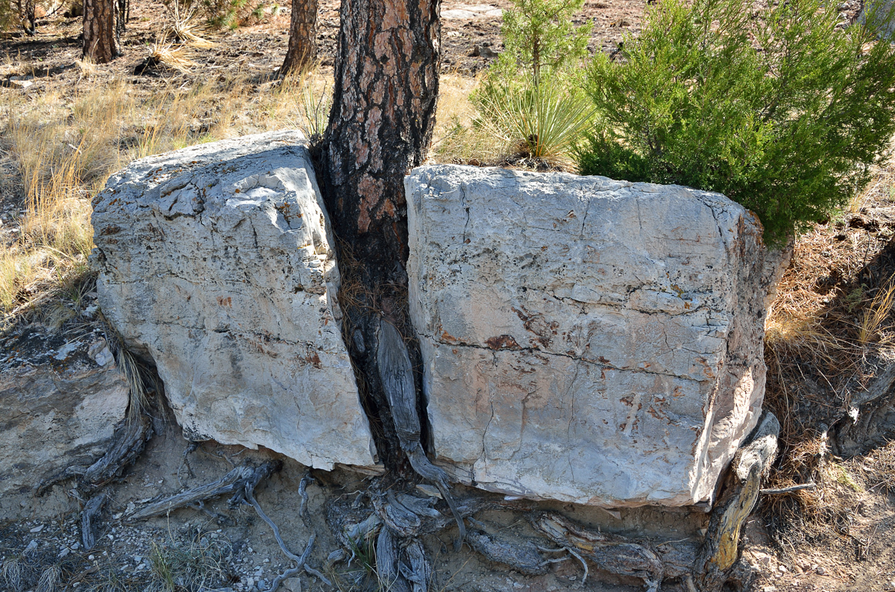

Slide 25
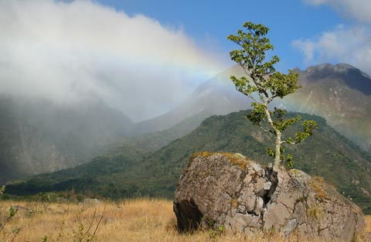

Slide 26
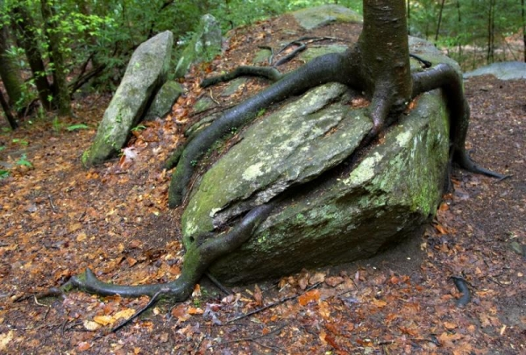

Slide 27
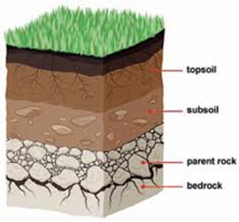
THIS HELPS CREATE…
SOIL!
DEFINITION:
Upper layer of earth that is a mixture of organic remains, clay, and rock particles

Slide 28
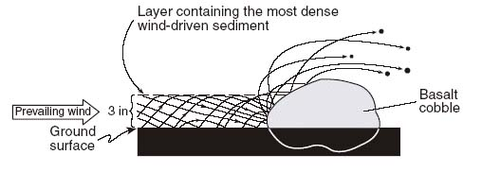
4. ______________________________
ABRASION:
Hitting rocks w/ sediments.

Slide 29

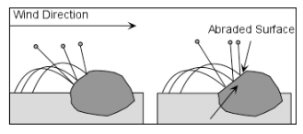

Slide 30
This causes RIVER ROCKS to become: __________ in shape __________ in texture __________ in size
ROUND
SMOOTH
SMALLER

Slide 31
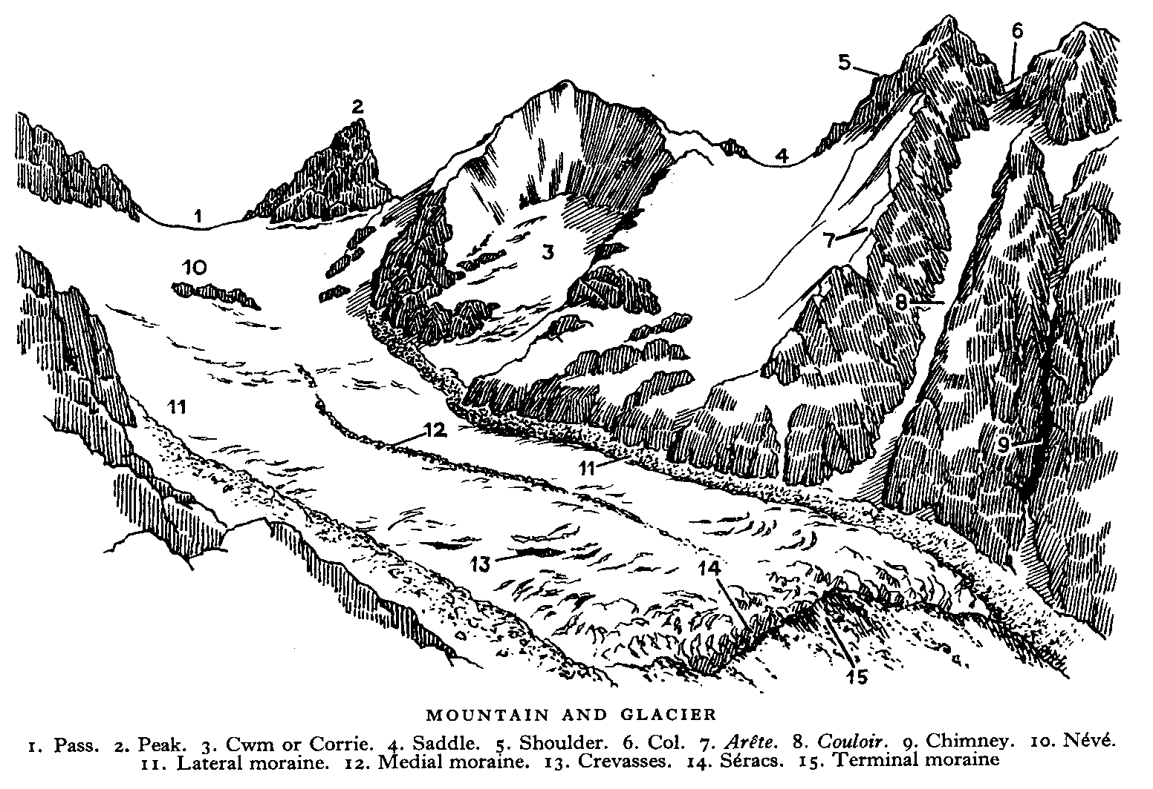
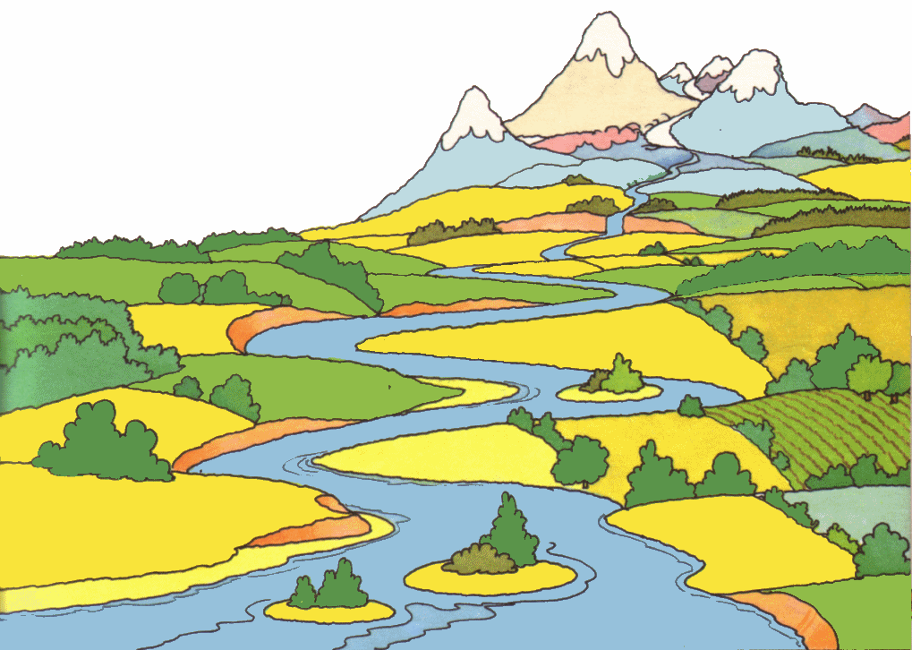

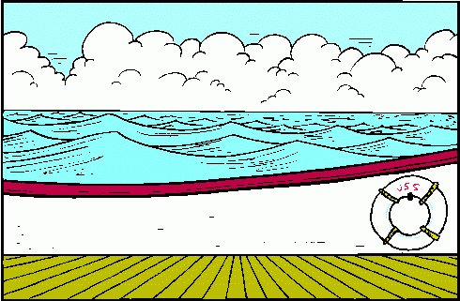
4 MAJOR CAUSES OF ABRASION:
GLACIERS
RIVERS
WIND
OCEAN
WAVES

Slide 32
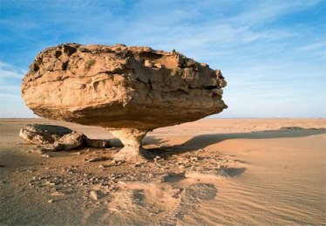
WIND: “PEDESTAL”

Slide 33
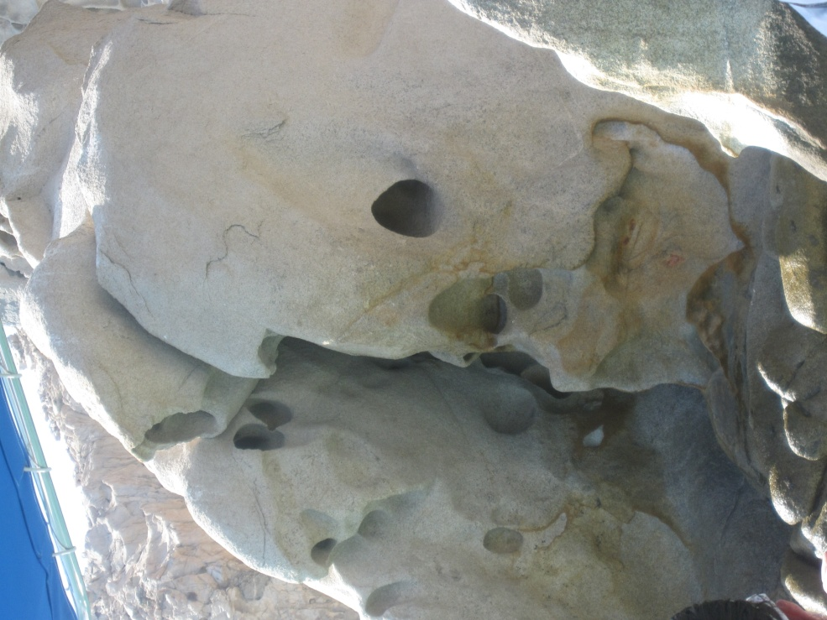
OCEAN WAVES

Slide 34
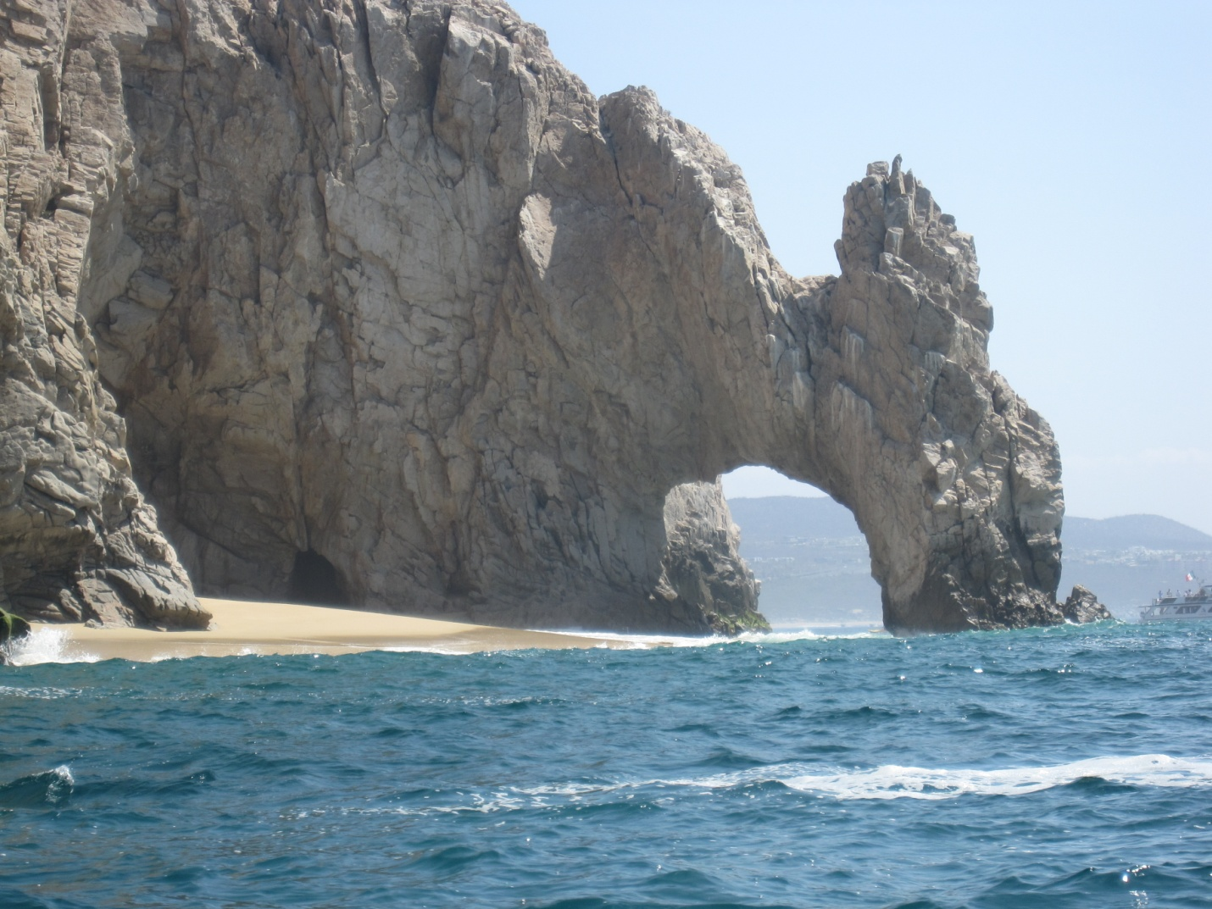
WAVE WAVES/TIDES

Slide 35
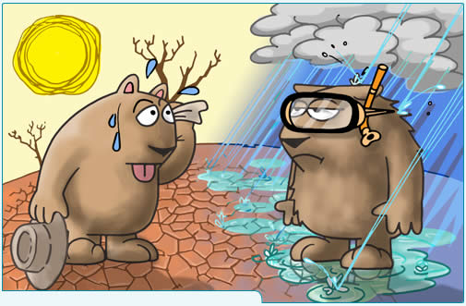
THE RATE OF WEATHERING IS AFFECTED BY…..
CLIMATE!

Slide 36
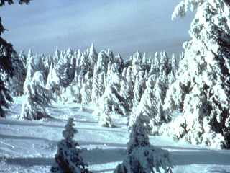
Physical Weathering
LOW
COLD
Increases in a _________ temperature ( )
& ___________ humidity ( ) climate.
HIGH
WET

Slide 37
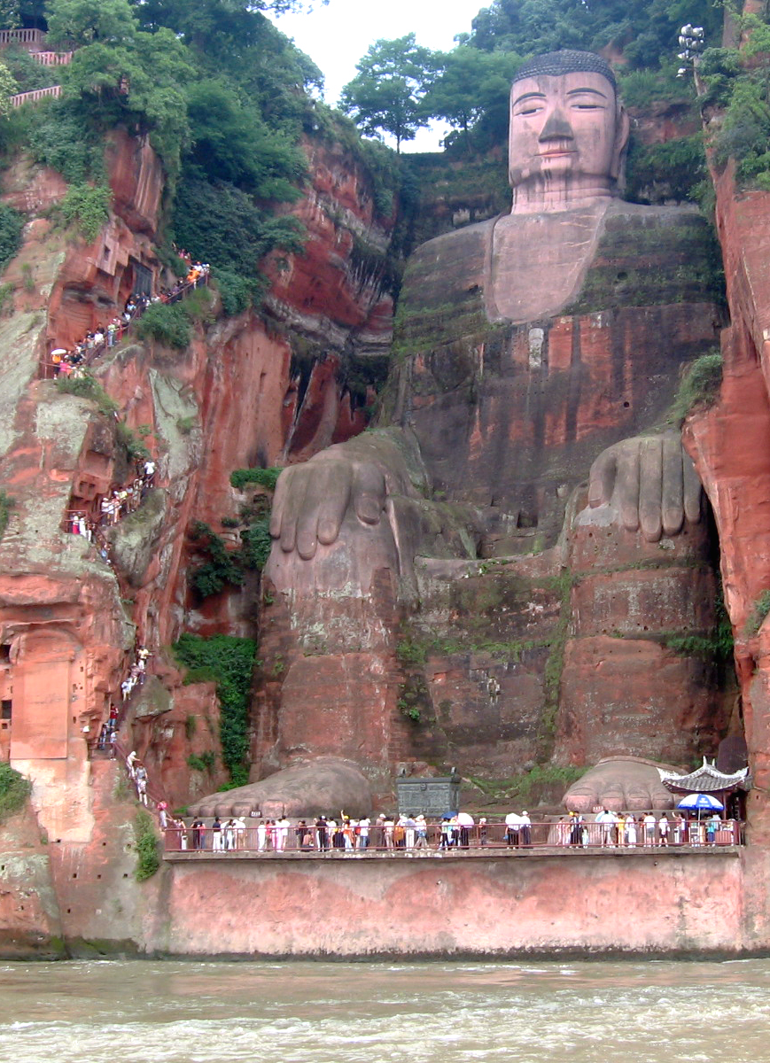
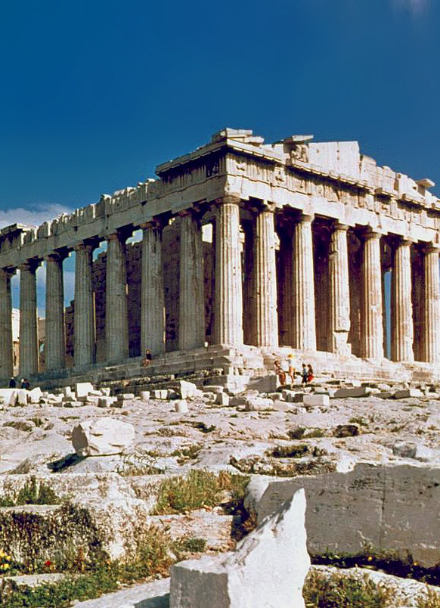
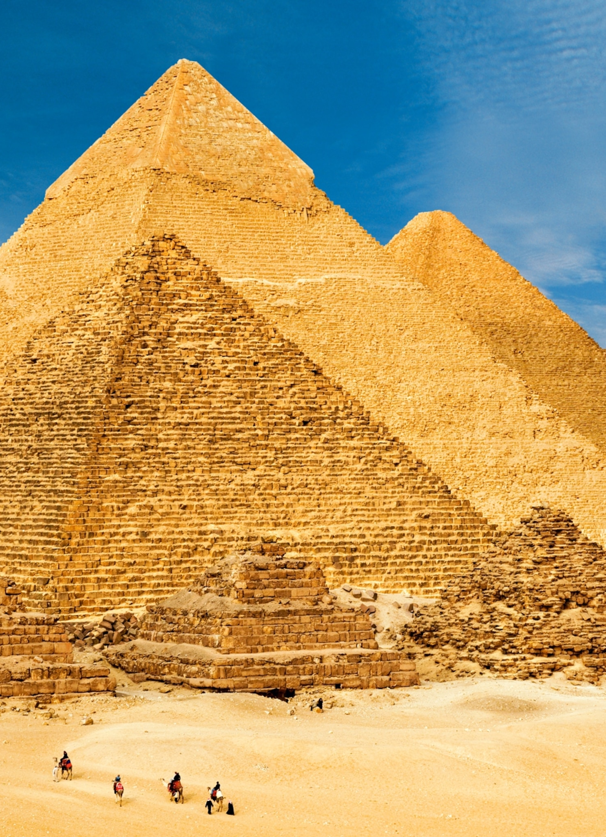
ANCHOR PHENOMENON
Giant Buddha of Leshan China
The Parthenon in Greece
Pyramids of Giza Egypt

